Slide 1

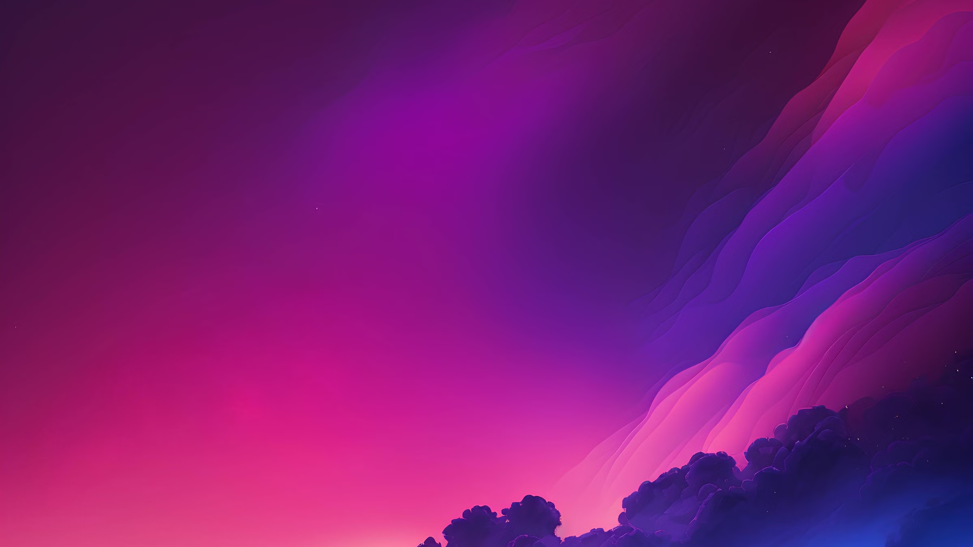

Patent
Gesture - to- Text and Speech System for Sign language Interpretation with Enhanced AI and Wearable Integration.

Slide 2
Introduction
The "Gesture-to-Text and Speech System" is a smart tool that helps people who use sign language talk to those who don’t understand it. It uses powerful technology like AI (Artificial Intelligence), computer vision (which helps the system see and understand hand movements), and wearable devices to turn sign language into text and spoken words instantly. This makes communication easier and more inclusive in places like schools, hospitals, offices, and public areas.

Slide 3
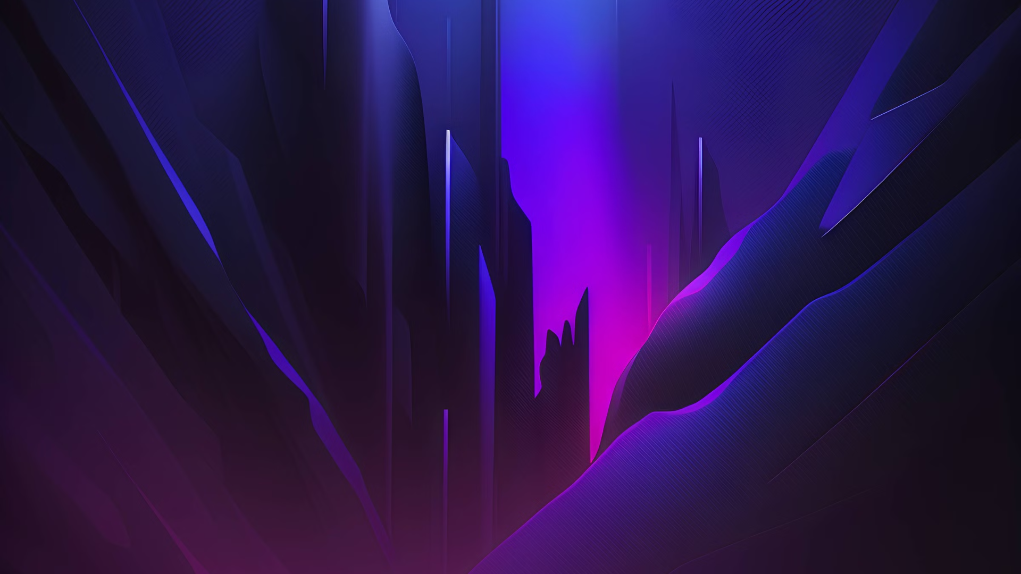
Objectives
• Accurately recognize sign language movements using a camera Translate hand movements into text and spoken language in real-time.
Example: If someone signs "Hello," the system will immediately say "Hello" out loud or show it as text on the screen.
• The system would enhance the accessibility of deaf and hard-of-hearing people to communicate easily in different environments.
• Provide a user-friendly and portable tool for daily communication.

Slide 4
Algorithms Commonly Used in Gesture Recognition Systems:
1.Hand Detection and Tracking:
Algorithm: MediaPipe Hands
2. Gesture Recognition:
Algorithm: CNN (Convolutional Neural Network)
3. Text-to-Speech (TTS) Conversion:
Algorithm: pyttsx3 library

Slide 5
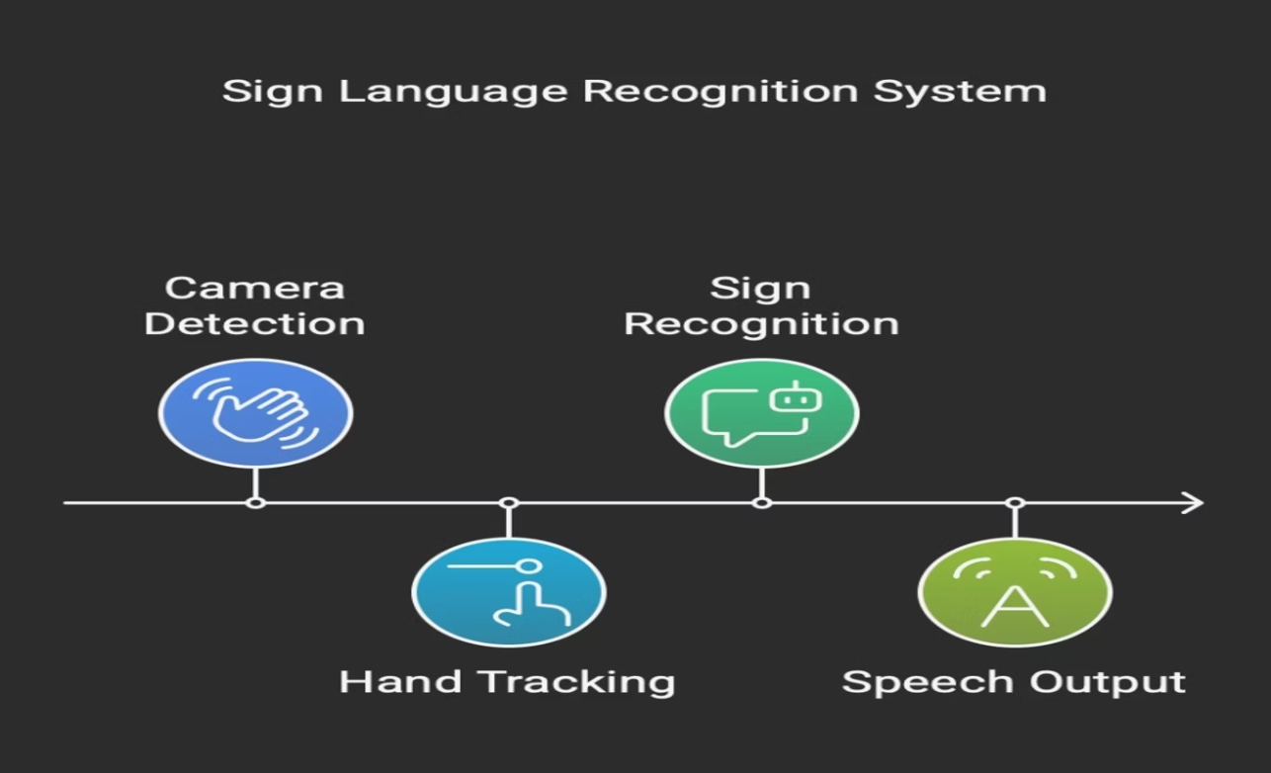

Slide 6
Scalability and Future Growth
Scale the system to incorporate full words and sentences as well as individual letters.
Improve AI models to recognize multiple sign languages (ASL, BSL, ISL, etc.).
Develop it into a compatible form for Augmented Reality (AR) and Virtual Reality (VR) hardware for greater access

Slide 7
Flaws or Limitations of the System
The system may get confused with similar or complicated gestures.
There could be a small delay while converting gestures to text or speech.
A camera or wearable device is required to detect gestures.
Movements or noise in the background might affect gesture detection.

Slide 8
Project
The Digital Art Inspiration Assistant

Slide 9
Introduction
The Digital Art Inspiration Assistant is an interactive web-based tool designed to help artists, students, and creative individuals find new ideas for digital artwork. It uses AI, art style databases, and real-time APIs to give users customized art prompts, color palettes, example images, and even generate artwork using AI. The tool works like a chatbot, making the experience fun, personal, and easy to use.

Slide 10
Objectives
•To provide users with personalized digital art ideas using AI.
•To inspire creativity by suggesting art styles, themes, and techniques.
•To visually support users with example images and color palettes.
•To allow AI-generated art creation based on user input using text-to-image models.
•To create a smooth and engaging chatbot-style interface for interaction.

Slide 11
Techniques Used (How it works):
Frontend Web Design: The website is made using HTML, CSS, and JavaScript for a smooth and colorful look.
Chat System: Users type what they want, and the bot gives creative replies or art ideas.
APIs Used:
Pexels API – Shows example pictures based on your art theme.
Colormind API – Gives nice color palettes for inspiration.
Stability AI API – Creates amazing AI art from your text idea.
Animations & Style:The site includes glowing buttons, floating particles, and stylish color effects to make the experience more fun.

Slide 12
Key Learnings
Learned how to use real-world APIs like Pexels, Colormind, and Stability AI to fetch data and images.
Frontend Development Skills :Improved skills in HTML, CSS, and JavaScript to build interactive and responsive websites.
Creating Chatbot Logic :Built a smooth chat-like interface that responds to user input.
Using AI in Creative Projects : Understood how to generate art using AI models like Stable Diffusion.
Design and User Experience :Learned how to make the website attractive, creative, and easy to use for artists.
Problem Solving :Faced real challenges like API limits, UI bugs, and made creative solutions.

Slide 13
Conclusion
The Digital Art Inspiration Assistant is a creative and interactive tool designed to help artists, students, and designers explore new ideas for digital art. By combining chatbot interaction with smart technologies like AI, APIs, and dynamic design, the system makes it easy and fun to generate art prompts, colour palettes, and even create AI-generated artwork.

Slide 14
THANK YOU

